Slide 1
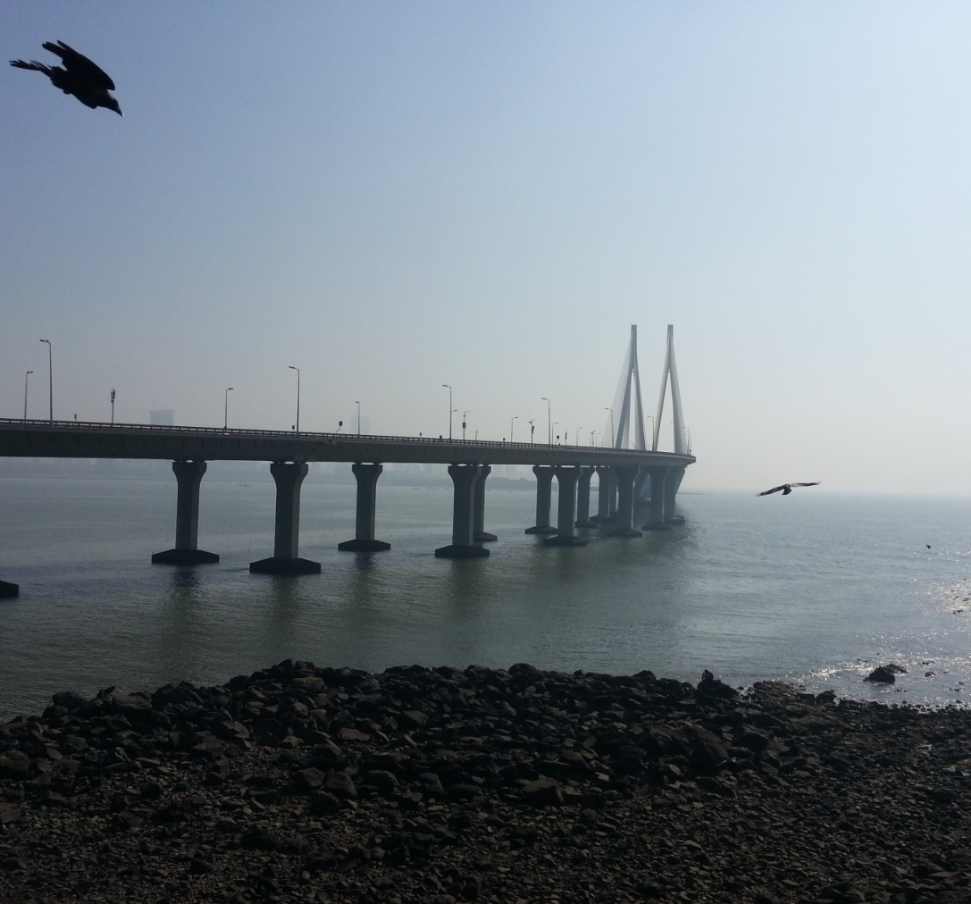
Rover therapist…
Shubham Chandak (47008) Ridhima Joshi (47020)
Madhur Lahoti (47028)
Radhika Sawant (47045)
Guided By:
Mr. C. A. Ghuge

Slide 2
Introduction
CRM
Optimal Path
Path Tracking
Fare Calculation
Security

Slide 3
Literature Survey
International Journal of Emerging Technology and Advanced Engineering Website: www.ijetae.com (ISSN 2250-2459, ISO 9001:2008 Certified Journal, Volume 4, Issue 3, March 2014
By: Nitin Khondre, Ravi Saini, Ronak Jain, Sarang Suryawanshi, Bushra Quazi ).
2009 3rd IEEE International Conference on Digital Ecosystems and Technologies Future Mobile CRM in Automotive and Tourist Area.
(By: Filipe Andre Gomes Batista, Nuno Rodrigues, Alexandrino Goncalves)

Slide 4
Cont…
On-Line GPS Track Simplification Algorithm for Mobile Platforms
(By: R. Ivanov)

Slide 5
Proposed System
Problem Statement:
To develop user friendly android application for tourist which guides them to explore.
Scope:
Limited to Maharashtra State.

Slide 6
Cont…
Objectives:
Navigate to current location
Listing tourist attractions
Fare calculation
Lodge complaint
Guide the tourist
Optimal path tracking
Auto fare calculation
Places history with images

Slide 7
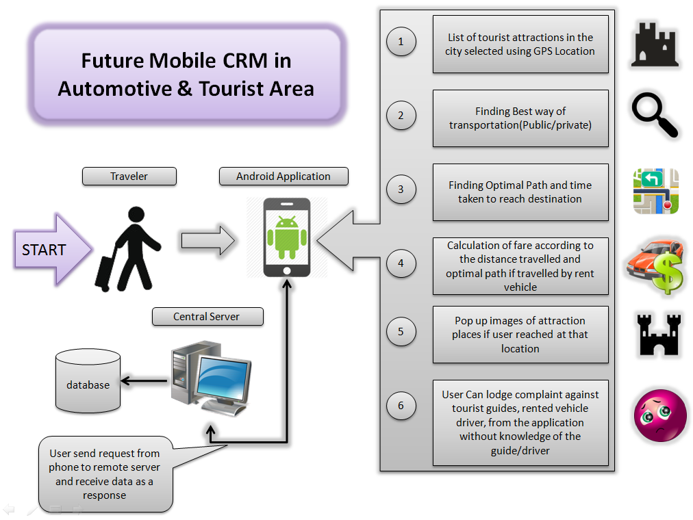
Fig: System Architecture

Slide 8
Project Flow
System Initialization
Listing Tourist Attractions
Optimal Path Tracking
Pop up image
Fare Calculation
Lodge Complaint
Listing The Emergency Numbers
Report Generation

Slide 9
Algorithm
Fig: GPS Tracking Algorithm
Start
Initialization
Add new point
Add point to track
Tracking
Optimize track
Checkpoint
End

Slide 10
ER DIAGRAM
Seasonal_classification
Information
Contact
Name
Email
Name
Complaint
Emergency No
Place
Category
City
Rover Therapist
Lodge Complaint
KM
Fare
Name
Contact
Price
Has
Source
GPS
Transport_Mode
Destination
Public
Private

Slide 11
Admirable Features
Image pop-up
Alert Messages if the Route is diverted
Seasonal Classification
Places list as per location
Text to speech
Auto fare calculation

Slide 12
Future Scope
Live Traffic
Climate Alert
Country

Slide 13
Advantages and Disadvantages
Advantages:
User can get tourist places from any local area with all description.
Displays route on Map
User can see fare of local taxi
Facility to launch complaints
Pop up’s images
Disadvantages:
Battery consumption is comparatively high because of GPS
Requires Internet on phone

Slide 14
Conclusion
Enhanced CRM core processes
Interactive CRM processes between business and customers
The app enable a nearly 24h accessibility

Slide 15
Thank
You!!

